Slide 1
EE461L Final Project
Spring 2021
GITHUB: https://github.com/gwyni/EE461L_Team-8_Project
WEBSITE: https://ee461l-team8.herokuapp.com/

Slide 2
Team Members
Gwyni Douglas
Roxana Far
Chad Harthan
Osama Iqbal
Kelly Wang

Slide 3
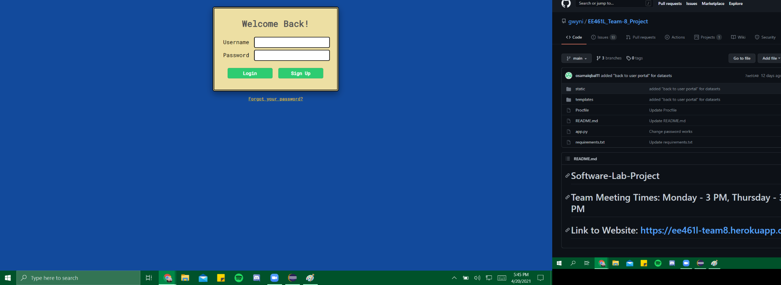
Login Page
Username and Password text boxes for users to type
“Login” button for returning users
“Sign Up” button for new users whose login info will be saved
“Forgot your password?” link for future implementation

Slide 4
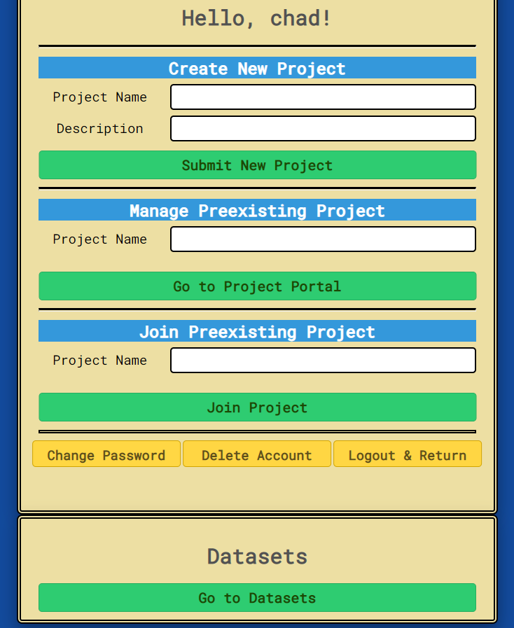
User Portal
3 manage account buttons at the bottom
Create New Project: Adding a project name and description will create new project.
Manage Preexising Project: Entering the name of a project the user is a part of will send them to project portal
Join Preexisting Project: Entering the project name will add the current user to the project
Datasets button takes user to dataset page.

Slide 5
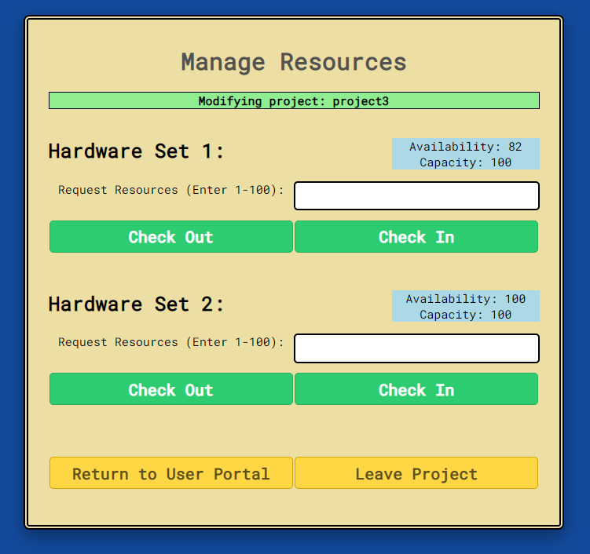
Project Page/Manage Resources Page
User can request a number of resources to check out or check in
Page shows project being modified
Buttons to Return to User Portal and Leave Project are available

Slide 6
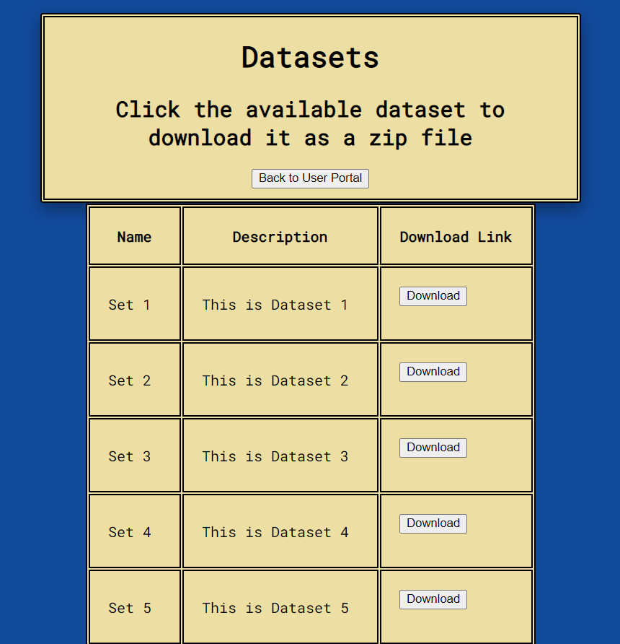
Datasets Page
User can view all available datasets with brief descriptions
All datasets can be downloaded in the form of zip files
User can navigate back to User portal using the dedicated button

Slide 7
Possible Features to Implement

Slide 8
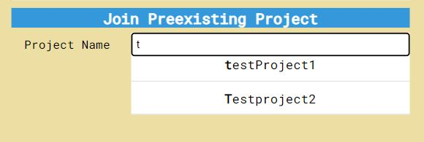
User Portal Features
A text autocomplete feature that searches the database for all pre-existing projects would assist users in finding projects they would like to join or manage. As a user types a project name, the website will show project names starting with that string.
This is useful for when there are many projects in the database since users may not know the exact name of the project they are searching for.
The user has typed in the letter “t” so the website suggests the pre-existing projects starting with “t”.
Notes:
We could fine-tune this text autocomplete feature for the Manage Preexisting Project input bar as well, as for that we would only display names of projects that the user is a part of.

Slide 9
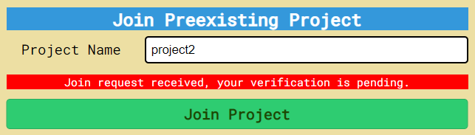
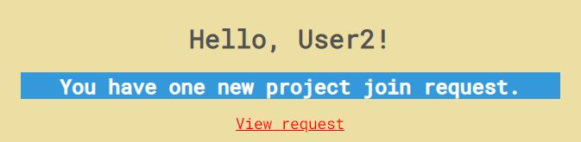
User Portal Features
User 1:
The user portal could notify users of new members that would want to join their project, so that current members could approve join requests. This acts as a security measure for individual projects by ensuring that only approved users can be in the project.
User 2:

Slide 10
Password Features
Forgot Password Feature: Clicking “Forgot your Password?” (already implemented) would show another HTML page with options. Possibly typing username or answering a secret question as confirmation would allow user to change their password on that same page (dynamically) which the back-end would save.
Change Password: User Portal Page has “Change Password” button already implemented, which would show another HTML page with more info. Typing username and password as confirmation on said page would prompt the same dynamic change password options.

Slide 11
Dynamic Manage Resources Page
HTML/CSS Front-End: Resources Page contains drop-down menu with list of Hardware Sets instead of two hardcoded Hardware Sets
Choosing a hardware set from the dropdown menu and then clicking “Update HWSet Information” button dynamically changes page and shows the resource information for the selected hardware set
Back-End reads from resources database and passes in a list of hardware sets to front-end HTML page
Upon pressing the update button, the current hardware set name in the dropdown list is sent by the “POST” method to the server
Back-End server stores the current hardware set through session variables

Slide 12
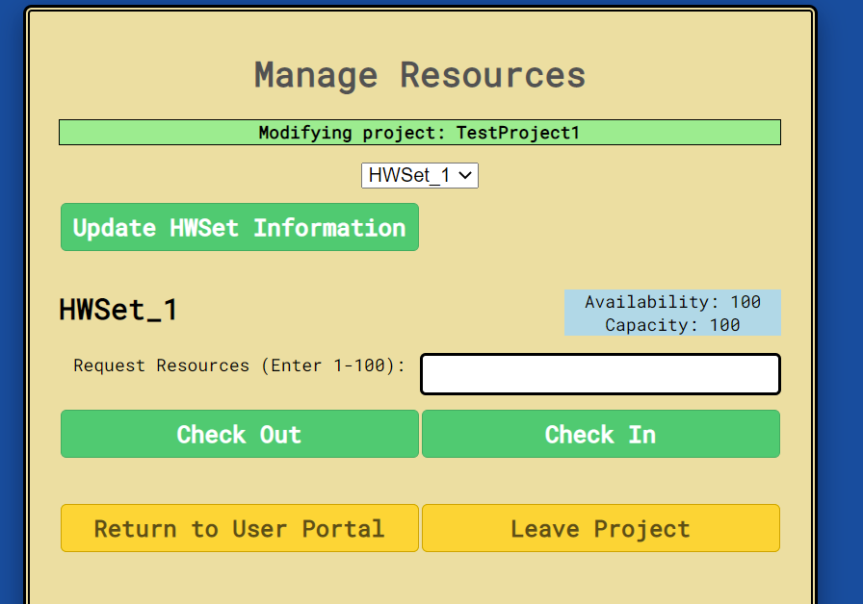

Slide 13
How We Tested

Slide 14
Manual Testing
< 50 tests on the current website
It would take longer to write automatic tests than to test manually
 | Expected Behavior
 | Unexpected Behavior but Does Not Result in Failure
 | Unexpected Behavior and Failure

Slide 15
Tests for Login Page
Component Being Tested | Input | Expected Behavior | Observed Behavior
Login Button | Empty Username Field | Error Message Saying No Username Given | Error Message Saying No Username Given
 | Empty Password Field | Error Message Saying No Password Given | Error Message Saying No Password Given
 | Both Fields Empty | Error Message Saying No Username and Password Given | Error Message Saying No Username and Password Given
 | Unknown Username | Error Message Saying that Username Hasn’t Been Created | No Message But No Log In
 | Known Username but Wrong Password | Error Message Saying Incorrect Password Given | Error Message Saying Incorrect Password Given
 | Correct Username and Password | Goes to User Portal Page Which Displays Username at the Top | Goes to User Portal Page which Displays Username at the Top
Component Being Tested | Input | Expected Behavior | Observed Behavior
Sign Up Button | Empty Username Field | Error Message Saying No Username Given | Error Message Saying No Username Given
 | Empty Password Field | Error Message Saying No Password Given | Error Message Saying No Password Given
 | Both Fields Empty | Error Message Saying No Username and Password Given | Error Message Saying No Username and Password Given
 | Already Used Username | Error Message Saying that the Username Already Exists | Error Message Saying that the Username Already Exists
 | New Username and Valid Password | Creates the New Login Credentials and Goes to the Login Page | Creates the New Login Credentials and Goes to the Login Page

Slide 16
Tests for User Portal Page
Component Being Tested | Input | Expected Behavior | Observed Behavior
Submit New Project Button | Empty Project Name Field | Error Message Saying No Project Name Given | No Message Displayed but Nothing Is Added to Database
 | Already Used Project Name | Error Message Saying Project Name Already Exists | No Message Displayed but Nothing Is Added to Database
 | Valid Project Name | Project Name and Description Are Added to Project Database | Project Name and Description Are Added to Project Database
Component Being Tested | Input | Expected Behavior | Observed Behavior
Go To Project Portal Button | Empty Project Name Field | Error Message Saying No Project Name Given | Message Displayed but Says Project Name Does Not Exist
 | Valid Project Name | User is Take to Project Portal Page and Project Name is Displayed at the Top | User is Take to Project Portal Page and Project Name is Displayed at the Top
Component Being Tested | Input | Expected Behavior | Observed Behavior
Go To Project Portal Button | Empty Project Name Field | Error Message Saying No Project Name Given | Message Displayed but Says Project Name Does Not Exist
 | Username Is Already in Project | Error Message Saying User is Already in Project | Error Message Saying User is Already in Project
 | Valid Project Name | Username is Added to Project’s List of Users | User is Take to Project Portal Page and Project Name is Displayed at the Top

Slide 17
Tests for User Portal Page Continued
Component Being Tested | Input | Expected Behavior | Observed Behavior
Change Password Button | Button Clicked | Goes to Change Password Page | Goes to Change Password Page
Component Being Tested | Input | Expected Behavior | Observed Behavior
Delete Account Button | Button Clicked | Username is Removed from Database and Popped from Session and User is Returned to Home Screen | Goes to Change Password Page
Component Being Tested | Input | Expected Behavior | Observed Behavior
Logout & Return Button | Button Clicked | Username is Popped from Session and User is Returned to Home Screen | Username is Popped from Session and User is Returned to Home Screen

Slide 18
Tests for Datasets Page
Component Being Tested | Input | Expected Behavior | Observed Behavior
Back to User Portal Button | Button Clicked | User is Returned to User Portal Page | User is Returned to User Portal Page
Component Being Tested | Input | Expected Behavior | Observed Behavior
Each Dataset Download Button | Button Clicked | Dataset is Downloaded onto Computer | User is Returned to User Portal Page

Slide 19
Tests for Manage Resources Page
Component Being Tested | Input | Expected Behavior | Observed Behavior
HW Set 1 Checkout | Request < Availability | Availability = Availability - Request | Availability = Availability - Request
 | Request > Availability | Error Message Saying that Much Can’t be Checked Out | Error Message Saying that Amount Can’t be Checked Out
 | Request = Availability | Availability = 0 | Availability = 0
HW Set 1 Check In | Amount < Capacity | Availability = Amount | Availability = Amount
 | Amount = Capacity | Availability = Capacity | Availability = Capacity
 | Amount > Capacity | Availability doesn’t change | Availability doesn’t change
HW Set 2 Checkout | Request < Availability | Availability = Availability - Request | Availability = Availability - Request
 | Request > Availability | Error Message Saying that Amount Can’t be Checked Out | Error Message Saying that Amount Can’t be Checked Out
 | Request = Availability | Availability = 0 | Availability = 0
HW Set 2 Check In | Amount < Capacity | Availability = Amount | Availability = Amount
 | Amount = Capacity | Availability = Capacity | Availability = Capacity
 | Amount > Capacity | Availability doesn’t change | Availability doesn’t change

Slide 20
Tests for Manage Resources Page Continued
Component Being Tested | Input | Expected Behavior | Observed Behavior
Return to User Portal Button | Button Clicked | User is Returned to User Portal Page | User is Returned to User Portal Page
Leave Project Button | Button Clicked | User is Removed from Project and Returned to User Portal Page | User is Removed from Project and Returned to User Portal Page

Slide 21
Tests for Change Password Page
Component Being Tested | Input | Expected Behavior | Observed Behavior
Change Password Button | At least one Empty Field | Error Message Saying There is an Empty Field | Error Message Saying There is an Empty Field
 | Wrong Old Password | Incorrect Old Password Error Message and No Change is Made | Incorrect Old Password Error Message and No Change is Made
 | Retype Password is Not the Same as New Password | Error Message Saying Mismatch in Passwords | Error Message Saying Mismatch in Passwords
 | All Fields are Valid | Password is Changed in Database | Password is Changed in Database
Go Back Button | Button Click | User is Returned to User Portal Page | User is Returned to User Portal Page

Slide 22
Adapting Testing Strategy to Scaling
Need to Move to Automatic Testing with Pytest
Example: User wants to add 100 hardware sets
Need to Automate the Check In and Check Out Testing for each hardware set
Would have 300 tests which would take too much time to do manually

